Slide 1
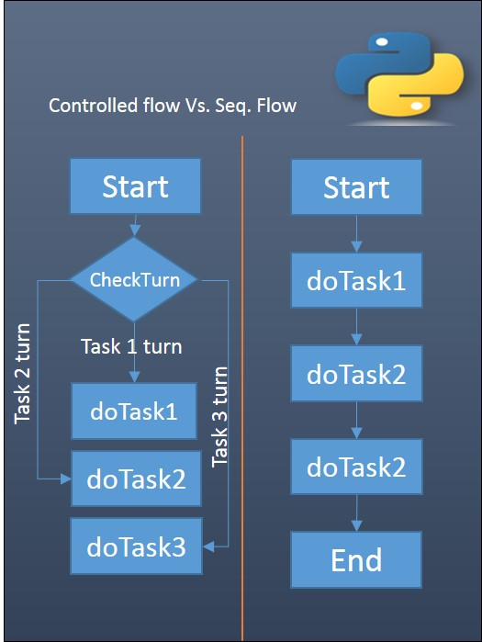
What is control flow?
1) Control, simply means controlling to get the intended behaviour.
2) Flow is just a way or sequence of program execution. By default every statement of program is executed one by one in an order they appear in a program code.
Notes:
Now, What is control flow? Don’t worry! It’s one of the simplest topics! explained above with two points!
control flow, simply means controlling the flow of program execution to get desired behaviour or result.
In the programs we have seen till now, there has always been a series of statements and Python faithfully executes them in the same order. What if you wanted to change the flow of how it works? For example, you want the program to take some decisions and do different things depending on different situations such as printing 'Good Morning' or 'Good Evening' depending on the time of the day?

Slide 2

Control flow tools
Python provide various tools for flow control. Some of them are if , if .. elif .. else, if..else,while ,for , switch, pass, range, break, else, continue etc.
Notes:
We know by now, what control flow is, but how to implement this?
Python provides us with various tools for that! No worries at all!
In this tutorial, I’ll be covering if-else, loops, break and continue statements, and at last pass statement.

Slide 3
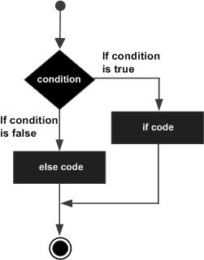
If-else statement
Syntax if(boolean condition): <if-block-goes-here> #optional else: <else-block-goes-here>
Example # Passing marks:50 marks=int(input('Enter marks: ')) if(marks>=50): print ("Student passed the subject") else: print ("Student failed the subject") Output Enter marks: 50 Student passed the subject
Notes:
First up is If-Else Statement! Now let’s try to understand its flowchart! As you can see, when we arrive at the condition block, the condition is checked whether its true or not, if the condition is true then if code is executed otherwise if the condition is false, else code is executed! Isn’t that easy!
If-Else statement can either be true or false based on the boolean condition.
If-Else statement is used when we have to make a choice. This could be made more clear by taking up an example, In this passing marks is 50
As you can see, if the marks entered are greater than or equal to the passing marks (50) then the program will print Student passes the subject else if the marks entered are less than 50 then the program will print Student failed the subject. As simple as that!

Slide 4
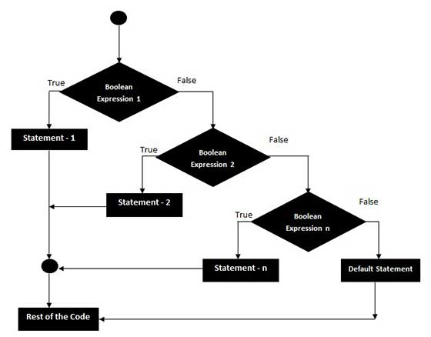
If-elif-else statement
Syntax
if(boolean condition): <if-block-goes-here> # zero or more elif(boolean condition): <elif-block-goes-here> # optional else: <else-block-goes-here>
Notes:
Next is if-elif-else statement, taking if-else statement to a next level!
Let’s try to understand using flowchart! Here you can see if boolean expression 1 is true then if block is executed, otherwise it will check for elif block i.e boolean expression 2,
Same process is repeated once again, if all the expressions are false then else block is executed.
The elif statement allows you to check multiple expressions for TRUE and execute a block of code as soon as one of the conditions evaluates to TRUE.
It will become more clear when I explain an example in the next slide!

Slide 5

If-elif-else statement: example
#Grade A:[90,100) marks
#Grade B:[75,90) marks
#Grade C:[50,75) marks
#Grade F:[0,50) marks
marks=int(input('Enter marks: '))
if(marks>=90):
print ("Grade A")
elif(marks>=75):
print ("Grade B")
elif(marks>=50):
print ("Grade C")
else:
print ("Grade F")
Output
Enter marks: 88 Grade B
Notes:
So let’s understand this example! Here you can see if entered/input marks are greater than or equal to 90 then Grade A is printed, Else if marks are greater than or equal to 75 then Grade B is printed,
Else if marks are greater than or equal to 50 then Grade C is printed and if all statements are false i.e if marks are less than 50 then Grade F is printed.
Now you have become pro in this thing! Explore it as much you can!

Slide 6
Quiz 1
Write a program that will input students theory and practical marks and print out whether they pass in theory and practical.In the end, print out whether the student passed overall.
# Passing marks:
# 1. Theory: 50/100
# 2. Practical: 65/100
# 3. Overall: 140/200
TheoryMarks=int(input('Enter Theory Marks: '))
PracticalMarks=int(input('Enter Practical Marks: '))
# TEST CASE:
# Input:
# TheoryMarks=60
# PracticalMarks=80
# Output:
# Passed in Theory
# Passed in Practical
# Passed Overall
# your code here
Notes:
Being Pro haan? Check this quiz out!

Slide 7
Loops
A loop is a common programming technique that allows us to repeat a specific instruction (or set of instructions) any number of times.
You have 0 apples. How would you give yourself 4 apples?
apples = 0
No Loops
apples += 1 apples += 1 apples += 1 apples += 1
For Loop
for x in range(4): apples += 1
While Loop
x = 0 while x < 4: apples += 1 x += 1
Notes:
Now coming to our next topic! Loops!
But why do we need loops? It’s used where we need a piece of code to be executed multiple times!
Rather than typing the same thing again and again we can reduce the redundancy and efficiency of the program using loop.
Isn’t that cool!
As we can see here in example if you have 0 apples and you want 4 apples! For and While loops come to the rescue!!!

Slide 8
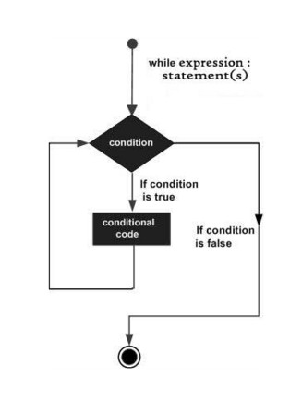
While loops
Syntax
while (boolean condition): # conditional code
Example Choice=1
while(Choice == 1):
marks=int(input('Enter marks: '))
if(marks>=50):
print ("Student passed the subject")
else:
print ("Student failed the subject")
Choice=int(input('Press 1 to find result of student: '))
Output
Enter marks: 15 Student failed the subject Press 1 to find result of student: 1 Enter marks: 93 Student passed the subject Press 1 to find result of student: 0
Notes:
Now that you know what a loop is, here’s the first type of loop: the while loop.
A while loop has two parts, the condition and the conditional code it contains.
The condition takes the form of a boolean. A while loop only executes its code while the condition is true. If the condition becomes wrong before any instance of the loop, the program will pass to the line immediately following the loop.
One thing you should know about Python is that it handles blocks of code differently from Java, C++ or JavaScript. Instead of wrapping curly brackets around the code you want to include in a loop, all statements with the same level of indent are considered to be part of a single block of code(indentation is important).

Slide 9
Iterables
range(size)
x = range(5)
size -> 5
[0...5-1]
x -> [0,1,2,3,4]
range(start,stop)
x = range(5,10)
start -> 5
stop -> 10
[5...9]
x -> [5,6,7,8,9]
range(start,stop,step)
x = range(10,5,-2)
start -> 10
stop -> 5
step -> -2
[10,10-2,10-2-2]
x -> [10,8,6]
Notes:
Before moving onto For loops, we’ll need to understand what an Iterable is. I hope you’re paying attention, because this is where things get tricky!
In Python, iterables are objects which can be treated as sequences, such as lists, arrays and range objects. The form of iterable you’ll be learning about today is the range object.
Each range object contains a list of integers, from least to greatest, that span from a starting value to the stopping value minus one, increasing or decreasing by a set number each time.
It’s quite simple to create a range object with a given size. Here I’ve set up three different range objects.
The first is a simple list, 5 integers long. If you aren’t familiar with zero-indexed lists, Python, like many programming languages, starts counting from 0 instead of one. That being said, this range starts at zero, and keeps counting up until it has filled up a list that’s the preferred size.
Second is a slightly more interesting list. It starts at 5, and counts upwards, but stops right before it reaches 10.
Up until the third list, you’ve seen ascending lists. Here’s one that descends! As you can see, it starts at 10, but increases by negative 2 each time, and stops just before its value would be less than or equal to 5.

Slide 10
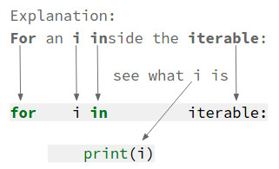
For loops
Syntax for i in iterable: # code
Example nums = [0,59,2,47,1,47,89,656,23,12]
for num in nums:
print(num)
Output 0 59 2 47 1 47 89 656 23 12
Notes:
Phew, we made it. Now that you know what Iterables are, it should be smooth sailing ahead.
Alright, For loops are different from While loops in that they don’t need something to be true to run! All you need is a defined iterable (whether it be a list, array, or range object), and you can create your own for loop.
Creating a for loop is quite simple. When ‘y’ is the iterable you’d like to count over, and ‘x’ is what you’d like to call the specific object in ‘y’, all you need to type is “for x in y”, a colon, then you’re set!

Slide 11

Quiz 2
Write a program to find result of 5 students.
# Passing marks:50
# your code here
Notes:
Now, time to test yourself! Try to do this question!

Slide 12
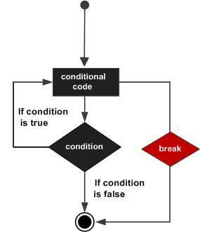
Break statement
for n in range(2, 10): for x in range(2, n): if n % x == 0: print(n, 'equals', x, '*', n//x) break else: # loop fell through without finding a factor print(n, 'is a prime number') Output 2 is a prime number 3 is a prime number 4 equals 2 * 2 5 is a prime number 6 equals 2 * 3 7 is a prime number 8 equals 2 * 4 9 equals 3 * 3
Notes:
Now time to learn something about break statement! What if you want to come out of loop after execution of a block of code? Break statement is the answer!
The break statement, like in C, breaks out of the smallest enclosing for or while loop. Loop statements may have an else clause; it is executed when the loop terminates through exhaustion of the list (with for) or when the condition becomes false (with while), but not when the loop is terminated by a break statement. This is exemplified by the following loop, which searches for prime numbers.

Slide 13
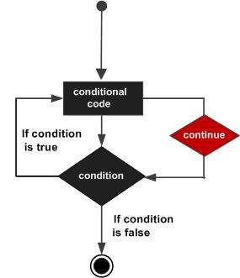
Continue statement
for num in range(2, 10): if num % 2 == 0: print("Found an even number", num) Continue print("Found a number", num) Output Found an even number 2 Found a number 3 Found an even number 4 Found a number 5 Found an even number 6 Found a number 7 Found an even number 8 Found a number 9
Notes:
Here comes the continue after the break statement! Brace yourself! The continue statement, also borrowed from C, continues with the next iteration of the loop.Following program finds even numbers.
Here when we encounter continue statement the compiler directly goes to the loop definition

Slide 14
Pass statement
for letter in 'Python': if letter == 'h': pass print ('This is pass block') print ('Current Letter :', letter) print ("Good bye!") Output Current Letter : P Current Letter : y Current Letter : t This is pass block Current Letter : h Current Letter : o Current Letter : n Good bye!
Notes:
Congrats! One last step before you become a control flow master! The last topic is pass statement! Pass Statement do nothing.They are used when a statement is required syntactically.The pass statement is also useful in places where your code will go eventually, but has not been written yet. Here you can see, when we encounter ‘h’ then only This is pass block is printed otherwise the print statment is always passed and is not executed, it’s executed only when we encounter alphabet ‘h’

